Slide 1
Internal Medical Services: An experience
Dr. Mahy I. – 2024

Slide 2
What to expect ?
Introduction
Present myself and the organisation I worked for.
Is Health important ?
Resources and Organisation of the Internal Service
Structure of the organisation and reporting
Quality Systems
Programs and assignments
Health Risk assessment programs
Health Protection Programs
Health promotion programs
Remarks and critical questions
Personal observations and reflexions
Questions

Slide 3
Presenting myself, and the organisations I worked for
INTRODUCTION
Worked 10 years for external service (1/2 time) during that time I started also ½ in Internal service
Internal service for UCB Chemical Plants - fulltime in 1998
Stand alone Chemical group (financial group UCB)
Part of US Chemical group - European function – Global Function – Cytec
Company from 4000 to 6000 employees - 14 to 20 countries worldwide
Sold to financial group - Allnex - US driven - headquarter in Germany
Joint Venture with Australian group
Sold to Thai – Chemical group – allnex
Personal Note: Evolution from paternalistic attitude to → Money driven attitude (Human to FTE (full time equivalent)

Slide 4
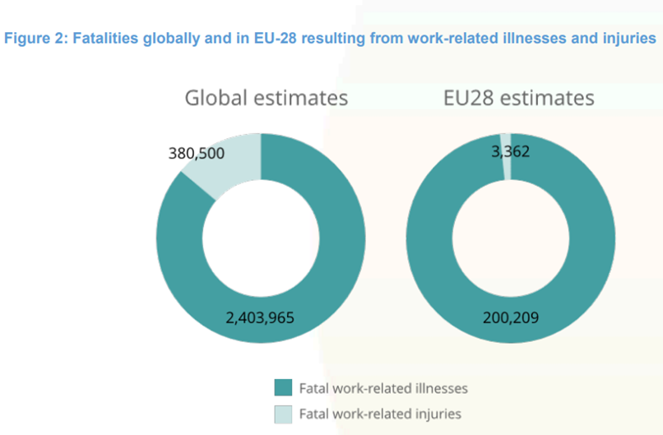
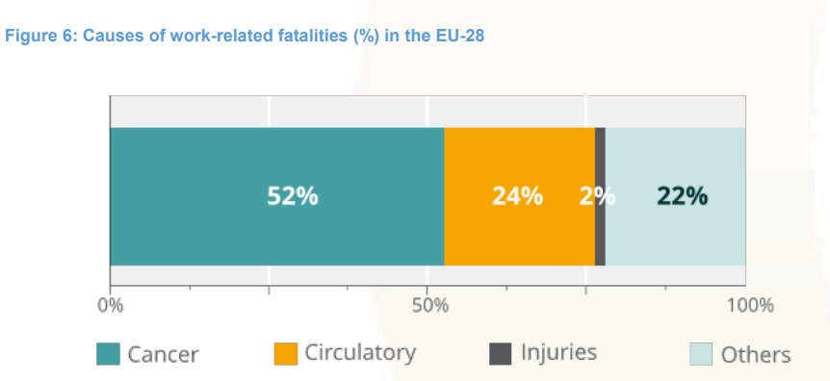
Is Health Important within companies ?
INTRODUCTION
Figures from EU-OSHA

Slide 5
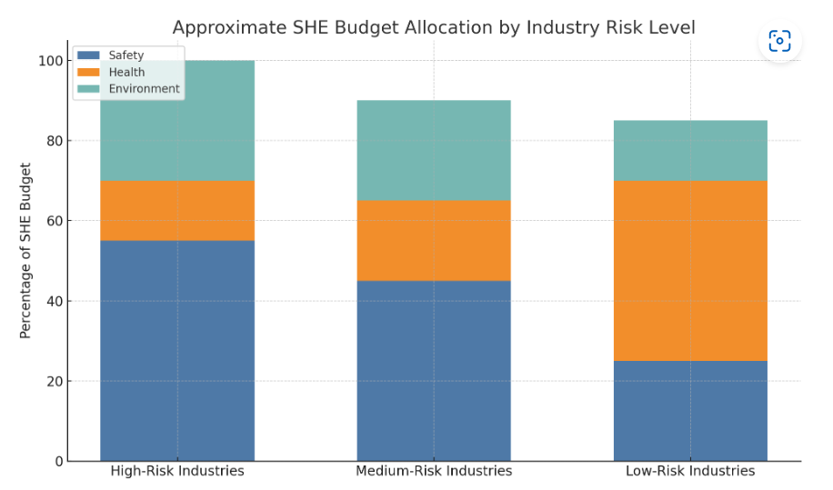
INTRODUCTION
Is Health really important for a company?
Personal Note: Health important in 2 cases : when you become ill and during new year receptions ! Longtime versus short time thinking !
Notes:
Ersus short time

Slide 6
Regional organisation: Centers of Competency
ORGANISATION
Global Occupational Health and Medical Services Director
Medical Services Assistant + COC Wellness
(Medical Coordinator EMEA + COC Occupational health)
(Medical Coordinator Asia Pacific - International SOS)
(Medical Coordinator America’s)
COC : Case Management
(Site nurse + COC Ergonomics)
(Site nurse + COC Medical Emergency response
Dr. China
Site Nurse: Coördinator Australia and New Zealand
Global HR
Global SHE
+ 30 Site Specific contractors
From 250 employees, on site nurse

Slide 7

Our vision
ORGANISATION
Occupational Health and Medical Services reports to Global HR / SHE
We work cross functionally on a continuous basis to support our vision:
“To be a center of excellence in Occupational Health, Medical emergency response and General Health promotion in order to optimize employee’s health and productivity in a safe and healthy workplace.”
Personal objective: Every employee must be in the same state of health when leaving the company. He or she must not have become ill due to work.
In case of discussion: Consult your objectives again and again:
- Has my time been used well?
- Are my priorities still right?

Slide 8

Certifications
ORGANISATION
Sites certifications can be an ally!
Recent example: the new certificates on sustainability; These play an important role in external recognition!
Health requirements are often included in this certificates
  ISO 9001
  a quality management system that delivers long term business benefits
ISO 45001
occupational health & safety management best practices that take care of our workforce
ISO 14001
an effective environment management system
ISO 50001
an effective energy management system
Personal note : from paper burden to an ally to free up money for health projects.
12 Global Health Standards
14 Linked Procedures and 6 Guidelines
Example: Standard : Biological risk assessment
Procedure: Legionella Prevention

Slide 9
PROGRAMS AND ASSIGNMENTS
Overview
Heath Risk Assessment Programs
Health Protection Programs
Health Promotion Programs
Chemical Exposure (CERA)
Physical Exposure (Noise, …)
Ergonomic Risks
JSERA
Other
Medical Examinations
First Aid Training
Case Management
Personal Protection Equipment
Travel Medicine
Training
Wellness Campaigns
Follow up on absence leave
Substance abuse
Vaccination Campaigns
Medical Confidentiality
SHE
SHE + HR
HR
References: - Local Legislation and culture
- SHE Standards

Slide 10
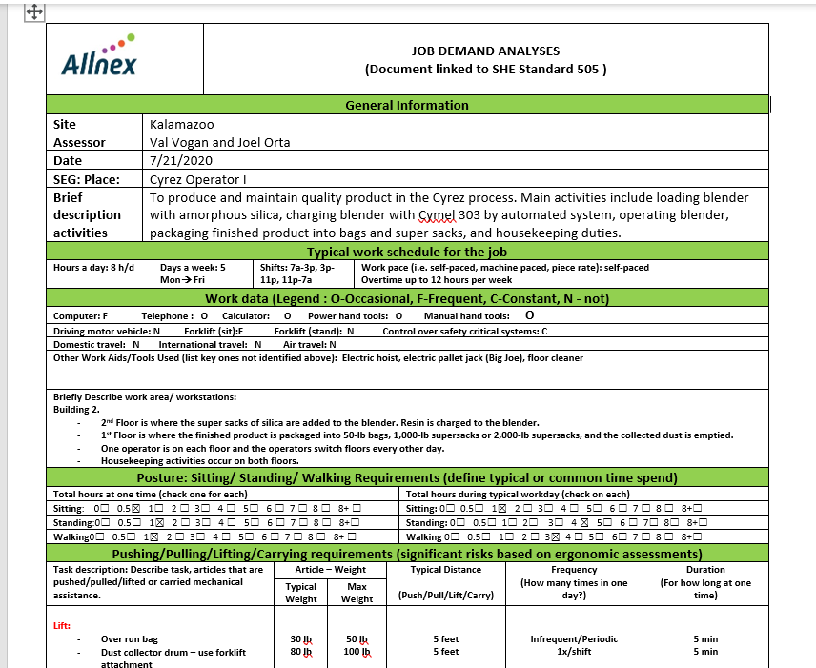
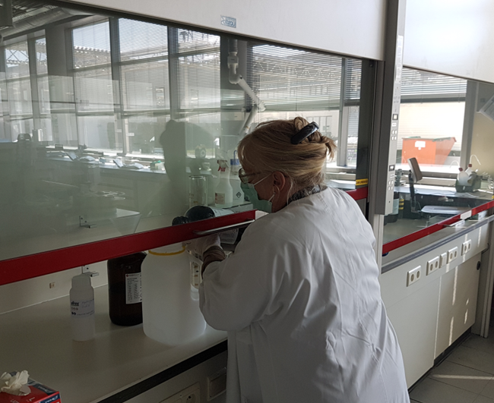
Health Risk Assessment Programs
PROGRAMS AND ASSIGNMENTS
Process
Mostly done by SHE team
Risk assessment
Overview of remaining risks and hazards : JDA
Written advise on risk assessment by Global Medical
Local Medical decides on content medical exams
JDA = Job Demand Analyses
Personal Note: Visit and sometimes do it yourself!

Slide 11
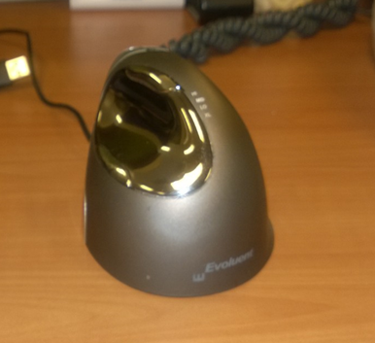

Health Risk Assessment Programs
PROGRAMS AND ASSIGNMENTS
Ergonomics – world wide
  Advise IT concerning new equipment - Global
  Advise new installations and productions parts
  Personal advice for workstation
  Follow up on complaints and incidents
Industrial Hygiene
  Advise around exposure and results of IH measurements
  Be aware that industrial Hygiene measurements are sometimes more expensive than adapting the workstation - common sense is important here
  Advise around introduction of new chemicals

Slide 12
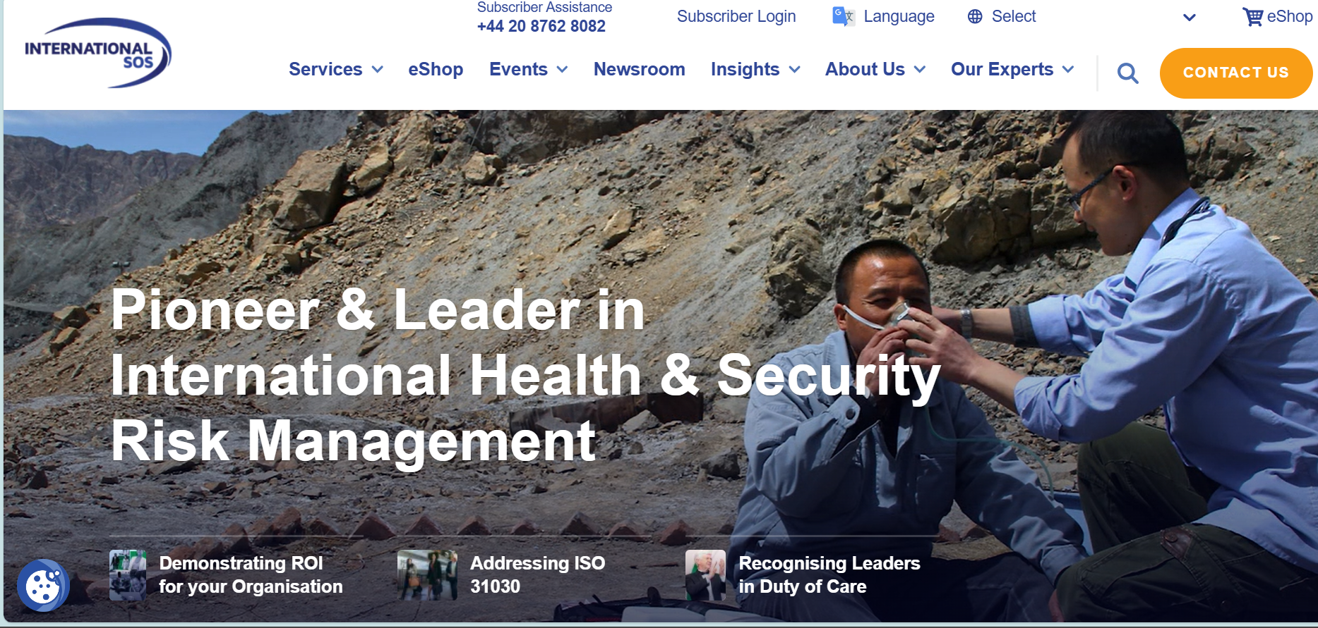
PROGRAMS AND ASSIGNMENTS
Health Risk Assessment Programs
Other : Global approach - mentioning of Stress in US sites was impossible - typically EU
Travel , global risk for employees who are doing more than 3 transatlantic flights in one year (Since Corona much lesser )

Slide 13
Health Protection Programs
PROGRAMS AND ASSIGNMENTS
Pre-placement - every employee world wide
  Alcohol and drug testing (except China)
  JDA - Physical testing in special centers (US)
Periodical Medical Examination - world wide and risk linked - some countries still extended medical check up (paternalistic approach)
Biological monitoring or special testing company defined ! Long function testing most important
CASE MANAGEMENT
  Return to work - timing linked to country - max. 4 weeks (standard)- US 3 days – Belgium: since 15 years contact with nurse after 14 days absence..
  Reintegration after injury or private accident
Personal Note: Were (legally) possible – frequency of periodical medical examinations linked to age - not for biological monitoring

Slide 14
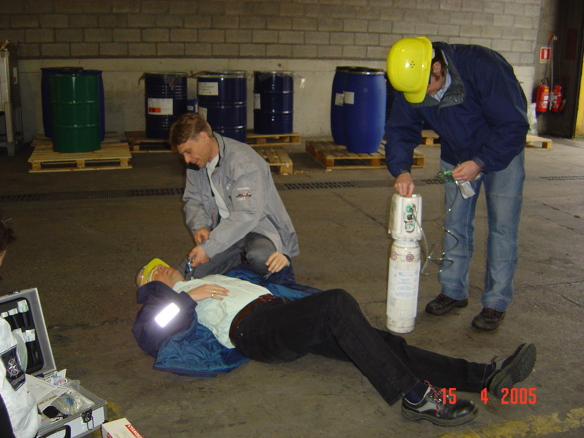
Health Protection Programs
PROGRAMS AND ASSIGNMENTS
First aid training
  Min 8 h/year
  Special chemicals training
  1 exercise with victim/year
Min requirements for first aid room
and first aid equipment.
Share incident experiences with all
medical employees
Set up biological monitoring after
incidents
Global Instruction Cards for
Chemical exposure : Example TDI

Slide 15




Exposure to sensitising substances
BE AWARE OF YOUR OWN SAFETY
Skin (H317)
Eyes (H319)
Air (H330)
Skin Irritation
Irritated Eyes
Short Of Breath Coughing Wheezing Breathlessness
Remove clothes
Shower (40 mins)
Put on new clothes (socks, underwear & don’t forget shoes)
Rinse 15 min
Wait for 5 min
Rinse another 15 min if irritation is persisting
Call ambulance
Half-upright posture Monitoring vital parameters No physical efforts
Oxygen 5 l
Removed clothing in sealed bag
Seek for medical advice
Corrosive substances: reactions can emerge 4 hrs later
Check burn
COMPLETE ACCIDENT FORM AND REPLENISH BOX

Slide 16
Health Protection Programs
PROGRAMS AND ASSIGNMENTS
Health Protection Programs
Personal protection
  Advise on new equipment
  Personal adapted PPE -
Travel Medicine
  Minimum requirements for vaccination (vaccination declination form)
  Travel kit
  Questionnaire - free medical examination
  International SOS : https://www.internationalsos.com/
    Link for information : medical website - travel portal
    Travel tracker

Slide 17
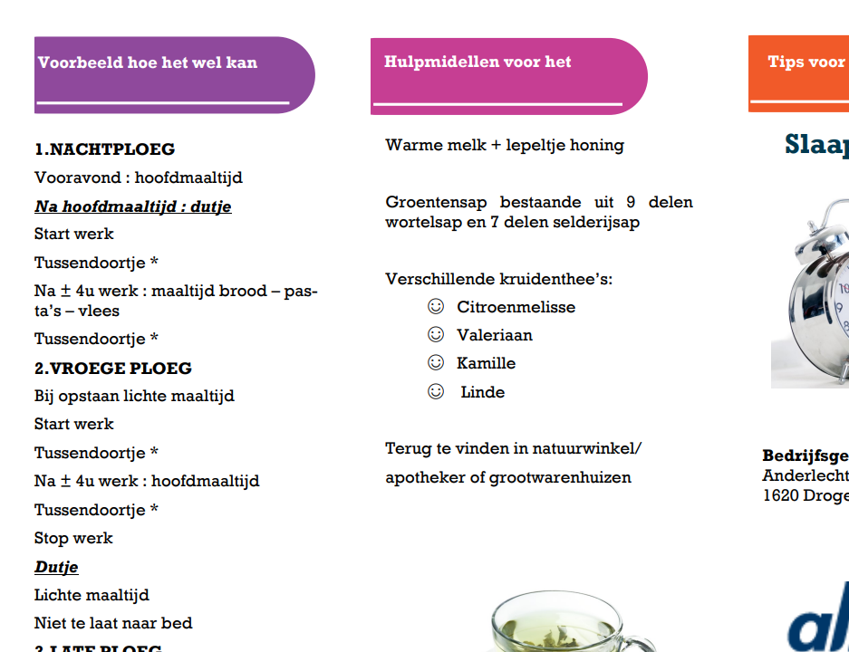
Health Promotion Programs
PROGRAMS AND ASSIGNMENTS
Training
  Medical and SHE ww, Monkey pox or PFAS what does that mean
  Local : working with carcinogens - reference to SHE for other sites
  Wellness training
  Folders for all employees
  example : sleep and work
  in shift

Slide 18
Health Promotion Programs
Global Wellness support : Myself and CoC Wellness
  One name : AllWell - one logo global – 4 global initiatives partially on global budget - Site ambassadors support are crucial - was existing structure in Cytec period
  Site managers play crucial role !
Global EAP Program : In US
mandatory reference possible.
Quarter 1:
Move well : sitting balls + instructions + reference good practices and other initiatives
Quarter 2:
Eat well: Picture competition of healthy food in Allnex + …
Quarter 3:
Be well: work life balance : real balance with daily rip in each site
Quarter 4:
Engage well: social/ family activity

Slide 19

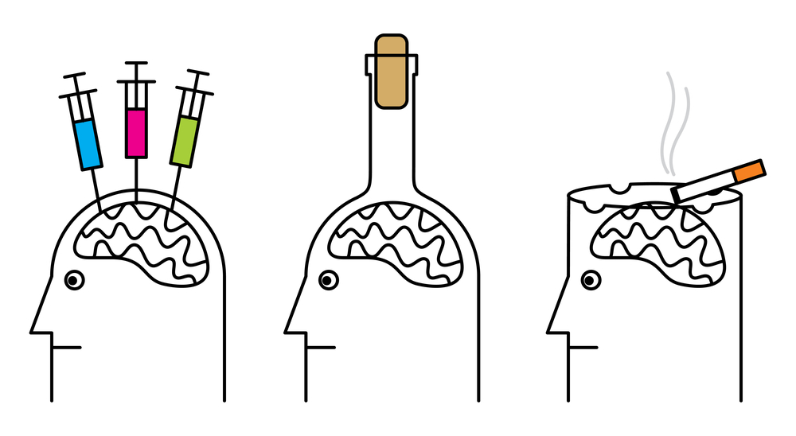
Health Promotion Programs
PROGRAMS AND ASSIGNMENTS
Absence leave :
  WW figures : targets same but was never a problem in US, Asia, Australia and Russia
  Targets 5% for blue color employees , 2% for White color employees
Substance abuse
  Country linked program (China exception)
  Pre-placement testing – also for students and temporary workers - zero tolerance
  Zero tolerance for being under influence during work
  Medication that has an influence → to OH dr.
  Accident linked testing – Random testing , organized by SHE and HR – not in EU - also for Management and
  Coaching for special cases together with General practisioner
Vaccination Campaigns :
  Flu : between 25 and 50 %
  Corona : Between 60 (US) and 100% (Thailand)
  First aid responders , travelers,

Slide 20

Health Promotion Programs
PROGRAMS AND ASSIGNMENTS
  Medical record keeping and Medical Confidentiality
  Company Health standard concerning medical confidentiality and recordkeeping - Global implementation is very difficult -
  Very cultural defined - example China absence leave figures , all results off biological monitoring in drawers of SHE , Korea
  Global medical Software program linked to HR Software in one way (HR → Medical)
    Upload of info during the night (New employees, leaving company, … )
    Strict minimum
Owner of Medical record :
EU : Docter
US : Employer
ASIA: HR, SHE even Management

Slide 21
Personal observations and reflexions
Health is not on the priority list of companies - we need to accept this and we need to sell our stuff.
Ask /discuss TARGETS for OH (cost must be challenged in sustainability certificates – not the number of medical examinations are important).
To solve the challenge of shortage in OH employees we should continue :
  To adapt frequency of physical medical examinations (content – age linked content)…
  Introduce more specific trained nurses or even trained she employees
  Promote common challenges with general practitioners – introduce them for certain tasks - internal ship for young portioners in occupational Health…
  Split training for Case Management and OH Prevention …

Slide 22
Other observations
- What does internal medical services mean in One word ? ( Colleagues, HR , SHE, ..)
  Permanent availability
  More possibilities ,
  Comfort
  More variation (different domains)
  Specialist
  Low-threshold confidential doctor in the company
  Wellness
  Freedom
  Meaning is different for everyone, there is no 1 internal service ! There no one Occupational Health Doctor -

Slide 23
Key difference between internal- and external Medical Services by chat GPT
Aspect | Internal Medical Service | External Medical Service
Service Provider | In-house staff (occupational doctors, nurses) | External providers (health clinics, specialists)
Cost | Higher upfront/operational costs | Lower upfront costs, but ongoing contractual fees and extra cost for specific support
Integration | Deeply integrated with company operations | Less integrated, more standardized services
Responsiveness | Immediate access on-site | Requires appointments, potentially less immediate
Customization | High level of customization | Limited, but can be negotiated
Confidentiality | Trusted but may raise privacy concerns | Perceived as more neutral and private
Expertise | May lack some specialized services | Access to broader range of specialists
Best for | Large companies or those with high-risk jobs | Small to medium-sized companies

Slide 24
Final Conclusion
Company who are & investing in comprehensive occupational health services Internal or External can improve a company's bottom line cost by reducing sick leave, preventing accidents, and boosting productivity. This companies not only invest in the current well-being of their employees but also in long term health of their workers.
Choosing between internal and external medical services depends on the size of the company, the nature of the work, the specific health risks employees face, and the company's resources. Internal medical services offer tailored, immediate care and better integration, but they are costlier and more suited to large organizations. On the other hand, external medical services provide flexibility, access to a wide range of expertise, and cost savings for smaller companies, though with potentially less direct control and responsiveness.

Slide 25

Questions?
Ina.mahy@hotmail.com

