Slide 1
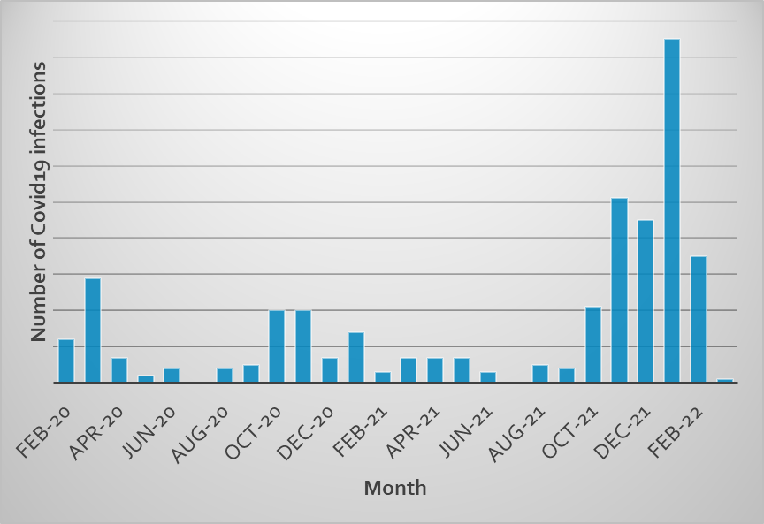
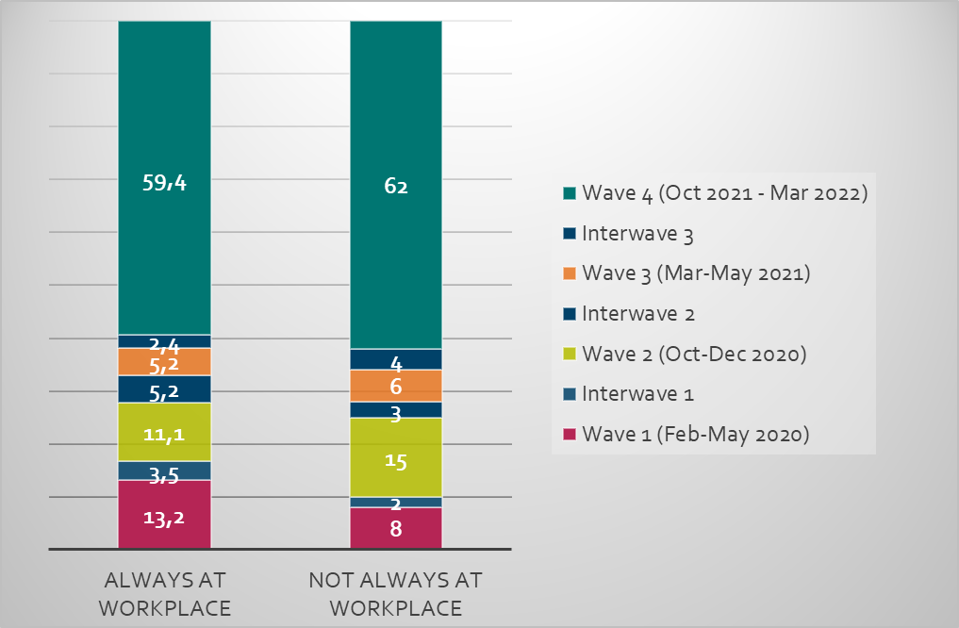
Cumulative incidence of Covid 19 in Belgian workers
Participation of IDEWE in COMETE (Covid19 Métiers Territoires), ORS Île de France
What was the incidence of COVID 19 in different professions, esp. key-professions during the 2020-2022 pandemic?
Which demographic, health- and work- related factors are involved?

